Slide 1


Name of Project
Energy Efficiency in Smart Buildings

Slide 2
Content
Abstract
Problem Statement
Objective
Data Collection and Preparation
Proposed Solution (Methodology)
Model Performance Evaluation
Screenshots / Demonstration (video)
Future Scope
Conclusion
Notes:
Abstract
Problem Statement (Clearly define the challenge)
Objective (State your project's goal)
Background and Research (Discuss existing solutions, trends, and gaps)
Data Collection and Preparation (Focus on data sources, cleaning, and augmentation)
Proposed Solution (Methodology)
Model Architecture (e.g., CNN, U-Net, YOLOv5)
Key Techniques (e.g., Transfer Learning, Image Augmentation)
Model Performance Evaluation
Metrics (Accuracy, Precision, Recall, IoU, etc.)
Graphs (Confusion Matrix, ROC Curve, etc.)
Screenshots / Demonstration (Visual proof of system functionality)
Future Scope (Improvements, scalability, and integration ideas)
Conclusion (Summarize results and impact)
Q&A Session

Slide 3
Buildings contribute ~40% of global energy consumption.
AI can significantly optimize energy use in smart buildings.
This case study highlights how AI enhances HVAC efficiency in commercial spaces.
Real-time data analytics and automation drive energy savings and cost reductions.
Abstract
Buildings contribute ~40% of global energy consumption.
AI can significantly optimize energy use in smart buildings.
This case study highlights how AI enhances HVAC efficiency in commercial spaces.
Real-time data analytics and automation drive energy savings and cost reductions.

Slide 4
Problem Statement
Traditional buildings are energy-intensive and inefficient.
Manual control of HVAC systems leads to energy wastage.
Sustainability goals require smarter, adaptive energy solutions.

Slide 5
Objective
To explore how AI improves energy efficiency in smart buildings.
To design a predictive model for energy consumption.
To provide actionable insights for facility managers.
To align with sustainability and cost-saving goals.

Slide 6
Data Collection and Preparation
Data Sources:
Building energy consumption (hourly)
Occupancy data
Weather conditions (temperature, humidity, wind)
Duration: 2 years of data
Preprocessing:
Handling missing values
Feature engineering (day type, HVAC status, hour of day)
Normalization/scaling for model input

Slide 7
Proposed Solution (Methodology)
Model Used: Random Forest Regressor / XGBoost
Inputs: Occupancy, weather, time-based features
Output: Energy consumption (kWh)
Steps:
Data preprocessing
Feature selection
Model training
Prediction & optimization
Feedback loop for real-time control

Slide 8
Model Performance Evaluation
Metrics Used:
RMSE, MAE, R² Score
Performance Snapshot:
RMSE: ~15 kWh
R² Score: 0.87
Interpretation:
Strong correlation between features and energy use
Effective for real-time predictions

Slide 9
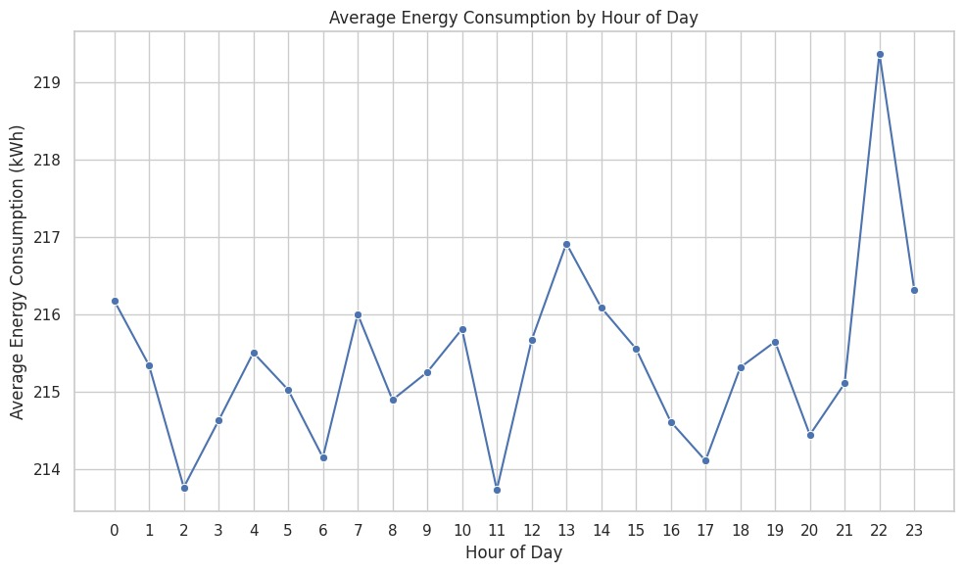
Screenshots / Demonstration (video)
https://colab.research.google.com/drive/1BluAPUQUkIeluDIktS-SNOH0BVh3Shlo
GITHUB LINK-Upload files · Vigneshwar2004/AG.

Slide 10
Future Scope
Integration with renewable energy sources (solar, wind)
Real-time anomaly detection and auto-correction
Scalable to large commercial complexes or smart cities
Feedback-based personalization for occupants

Slide 11
Conclusion
AI-driven systems offer tangible improvements in energy efficiency
Real-life implementation in Singapore shows 20% energy savings
Predictive analytics enhances operational control and sustainability
A step forward toward net-zero energy buildings

